Slide 1


SPARK V
Motion Control using I/O Ports

Slide 2
Various Motions of SPARK V
Forward
Reverse
Right Turn
Left Turn

Slide 3
Various Motions of SPARK V
Soft Right
Soft Left

Slide 4
Direction Control
Two DC motors are connected to PB0, PB1, PB2, PB3 Pins of the microcontroller.
Speed is controlled by Pin PD4 and PD5.
IC L293D is used as a driver between the microcontroller and the DC motors.

Slide 5
Direction Control
Microcontroller Pin | Function
PD4 | Pulse width modulation for the right motor (velocity control)
PD5 | Pulse width modulation for the left motor (velocity control)
PB0 | Left motor direction control
PB1 | Left motor direction control
PB2 | Right motor direction control
PB3 | Right motor direction control

Slide 6
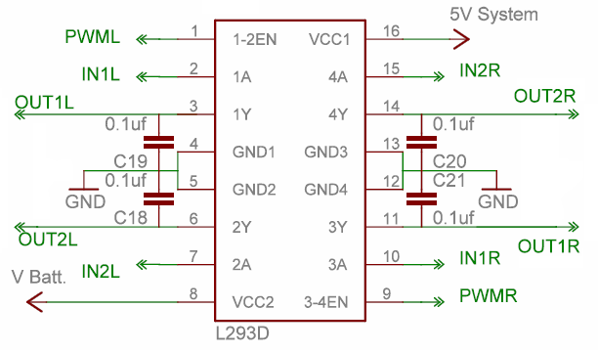
Block Diagram of L293D IC

Slide 7
Logic table for direction control of Motors
Left Motor
Right Motor
Output on PORTA
Direction Of Robot
PB0
PB1
PB2
PB3
0
0
0
0
0x00
Stop
0
1
1
0
0x06
Forward
1
0
0
1
0x09
Backward
1
0
1
0
0x05
Hard Left
0
1
0
1
0x0A
Hard Right
0
0
1
0
0x02
Soft Left
0
1
0
0
0x04
Soft Right

Slide 8
Motion Control Programming
Write function : INIT_PORTS();
Initialize Ports: Port A and Port L
DDRB=0x0F; //0000 1111
PORTB=0x00;
DDRD=0x30; //0011 0000
PORTD=0x30;

Slide 9
Motion Control Programming
Call functions like:
FORWARD();
REVERSE();
LEFT_TURN();
RIGHT_TURN();
STOP();
In between introduce delay:
_delay_ms(1000);

Slide 10
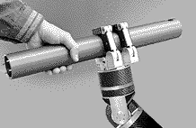
Thank
You

